Slide 1
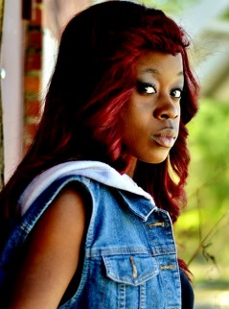
THE MARANATHA YOUTH DEPARTMENT INVITES YOU TO
AY @ 5:00 PM
“In the Midst”
Playwright/Director:
Maylore Demesmin
DIVINE WORSHIP @ 11AM
Speaker: Denard Fenaud
“Repairing the Breaches”
Saturday, October 31, 2015
Modern day Christianity through the stories of King Josiah and Job.
www.maranathasda.org l AY@maranathasda.org

