Slide 1
Notes:
On Sabbath, March 21st, youth at Maranatha will be teaming up with 8 million other Seventh-day Adventist youth to participate in Global Youth Day. The General Conference has designated this day as a day of service. Youth are encouraged to “be the sermon” instead of just listening to one.
While we will have normal Sabbath School, our Divine Worship experience will be abbreviated. We will worship for approximately 1 hour before taking part in our service activities for the day.

Slide 2
431 West Virginia Street
Notes:
We have partnered with The Shelter here in downtown Tallahassee. The Shelter provides temporary housing, food, minimal medical, and other assistance for the poor and homeless in our area. The Shelter has let us know that they have pressing needs for items like . . .

Slide 3
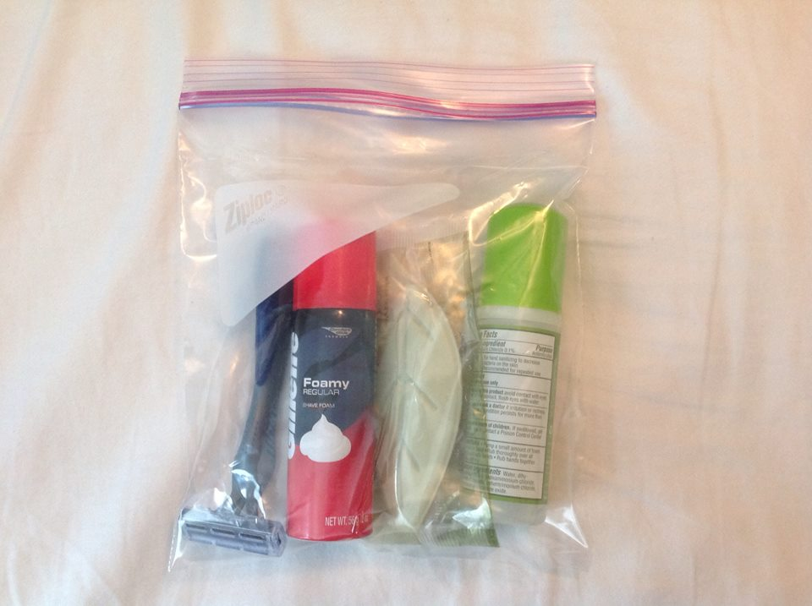
Donation Items Needed
Razors
Shaving Cream
Deodorant
Bathing Soap
Notes:
. . . razors, shaving cream, deodorant and bathing soap.
Our goal is to make 200 individual bags to pass out at to the individuals at The Shelter on that day. Each bag will contain one of these items and we need your help to make this happen.
We will provide the 1 Quart-sized ziplock bags but we need your help to fill them. On your trip to Wal-Mart or Costco this week, please consider getting some of the items listed here. They don’t have to be expensive name brands, just small enough to fit in a 1 Quart-sized ziplock bag.

Slide 4
Donation Sign-Up Sheet
Item | Amount | Name
Notes:
In the lobby, we have a sign up sheet where you can let us know which items you intend on bringing and how many. We want to do this is an organized fashion and don’t want to end up with 1,000 razors and no shaving cream. So work with us to accomplish this goal in an organized manner.

Slide 5
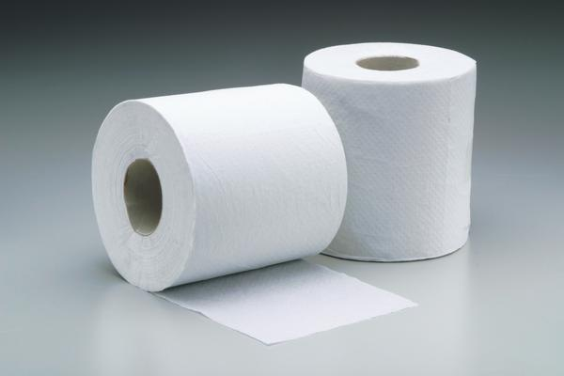
Donation Items Needed
The Shelter uses approximately 52 rolls of toilet tissue each evening.
Notes:
In addition to the other items we listed, representatives at The Shelter let us know that a continual need is for toilet tissue. They go through about 50 rolls a day and they can never have too much. So, please feel free to put a pack of toilet tissue in the boxes as well.
While we are at The Shelter, we will also participate in some light cleaning of the facility as well. So, we need as many hands as we can get to go with us.

Slide 6
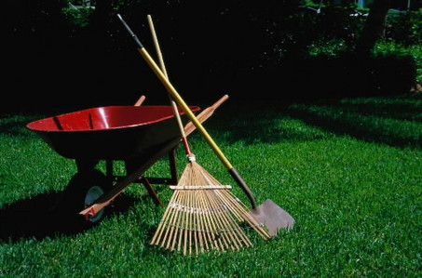
Donation Items Needed
Some of us will assist a local elderly person who cannot afford some basic yard work.
Notes:
Some of us will assist a local elderly person who cannot afford some basic yard work.

Slide 7
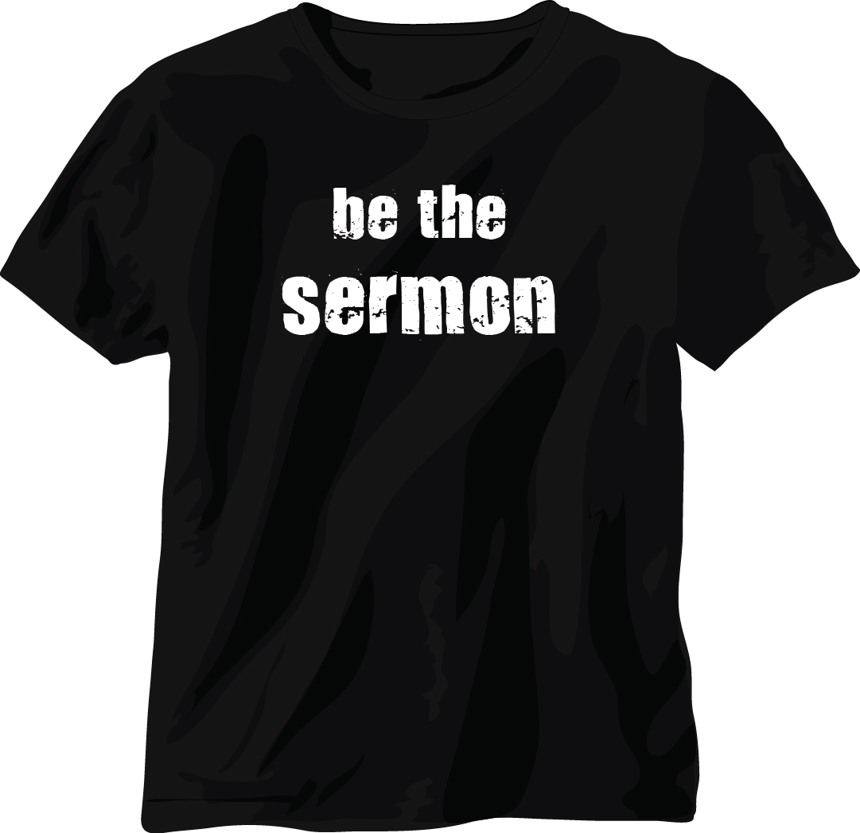
We want everyone to have a t-shirt!
$7.00 donation
Sign-up Sheet
in Lobby
Notes:
Pastor has given us the okay for everyone who is participating to come to church wearing our official t-shirt for the day. It will have the Global Youth Day logo on the front and the theme “Be the Sermon” on the back along with our church’s website address. We want people to know where we come from and who we represent.
So, please sign up for a t-shirt in the lobby. We will have make them available at church the Friday evening before the day of service on March 20th. All we are asking is that if you have the $7 per shirt, please place it in the tithe envelope and write GYD Youth Day so we know what it is for. If you don’t have the $7 but want a shirt, place your name on the list. If you can’t participate but want to donate to help out with the shirt purchases, please place that amount on the tithe envelope and write $7 on their as well.
Thank you in advance for your support.

Slide 8
Notes:
We hope that you will join us in making an impact and living out a sermon on March 21st.
If you have any questions, see an AY leader or send an email to AY@maranathsda.org.

